Slide 1
Important Concepts

Slide 2
Contents
Conditional Probability
Naive bayes
Support Vector Machines
xgboost

Slide 3
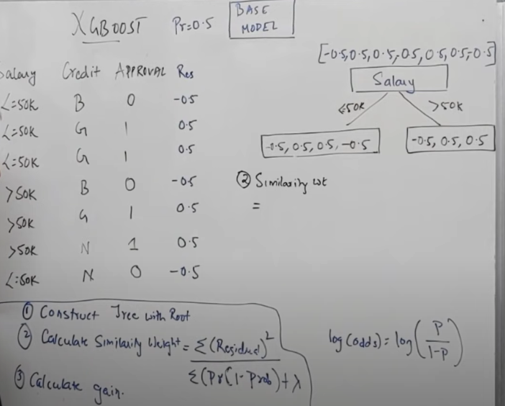
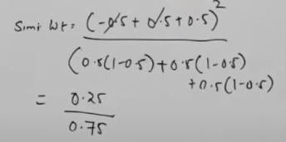
xgboost

Slide 4
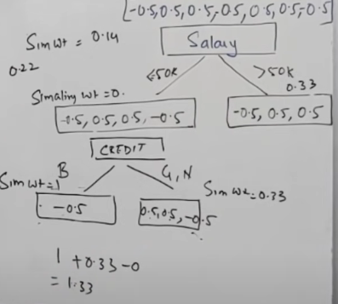
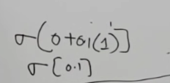
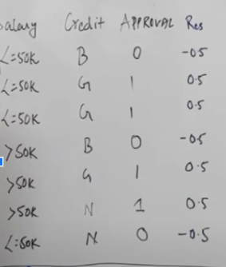

xgboost : Information Gain
Assuming my base model is giving output of 0 for one record, so sigma(0+0.1X1)
Applying sigma to the value > calculate new probability > calculate residual

Slide 5
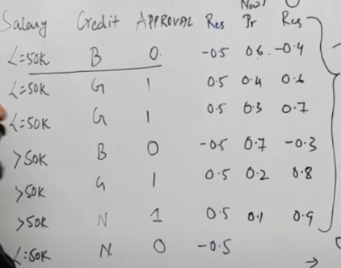

Slide 6
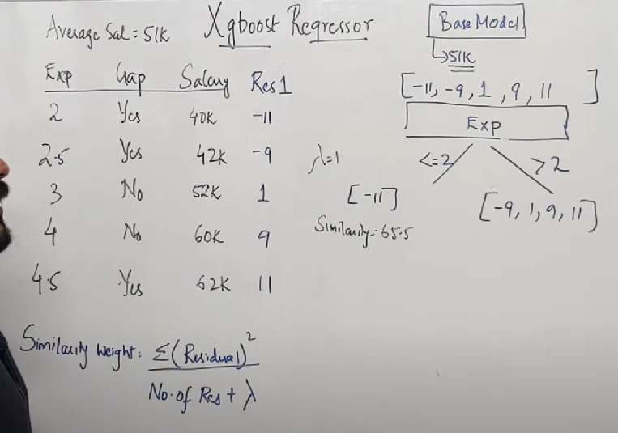
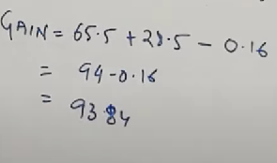

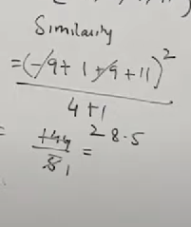
xgboost regressor

Slide 7
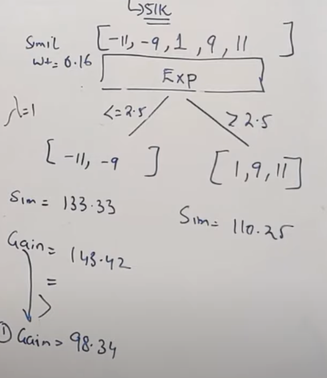
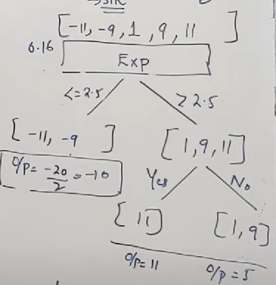
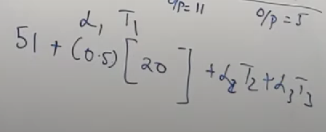
Splitting by using next record and checking information gain
Calculating output for one record=
base DT value + learning rate X DT1 output

Slide 10
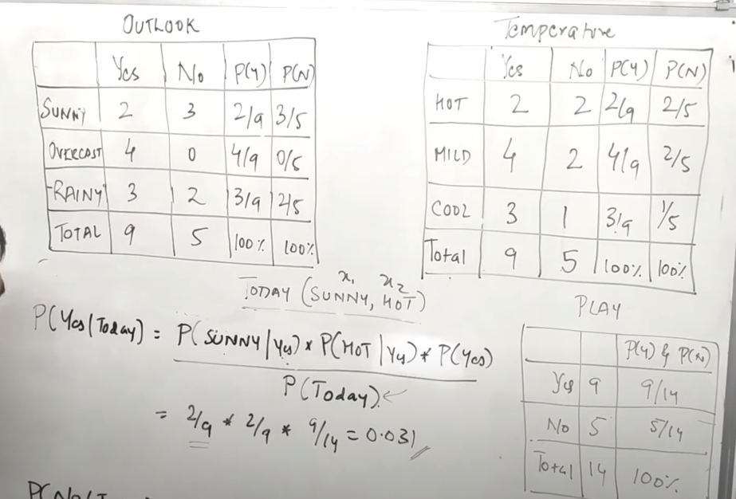
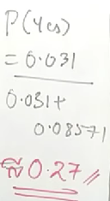


Naive Bayes

Slide 11
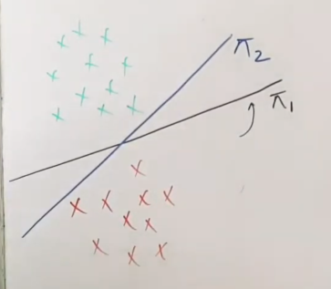

SUPPORT VECTOR MACHINE

Slide 12
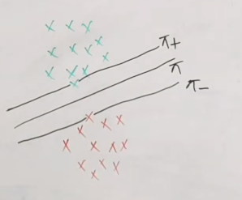
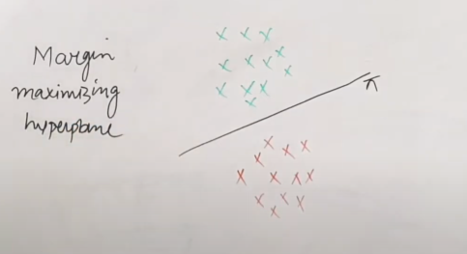
SUPPORT VECTOR MACHINE
Margin: Calculate shortest distance

